Slide 1
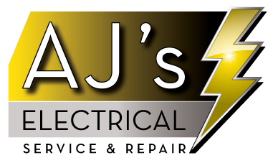

Slide 2
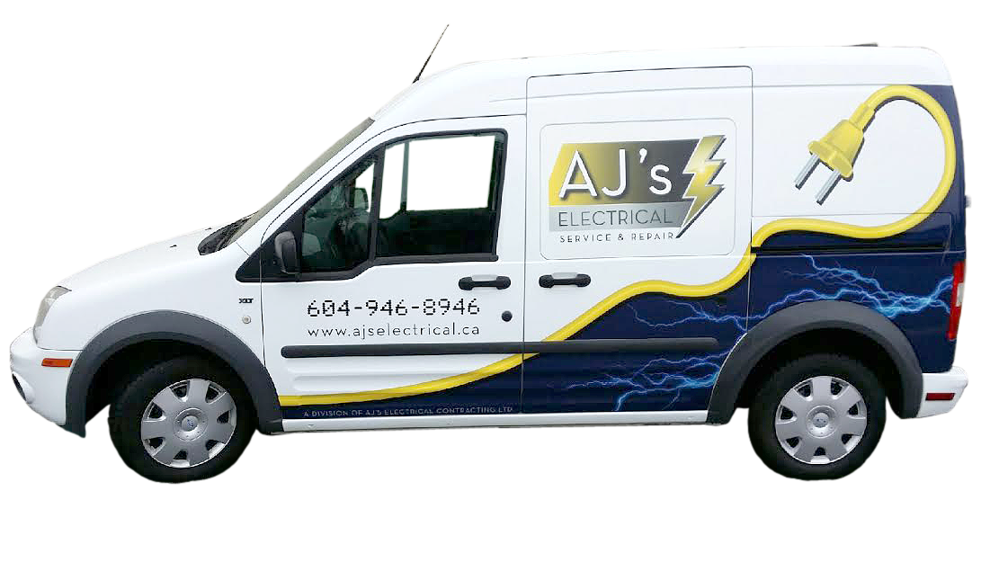
Let one of our dedicated Service Trucks come to help you with your electrical needs

Slide 3

Let our Courteous Service Electricians
”LIGHT YOUR WAY”

Slide 4
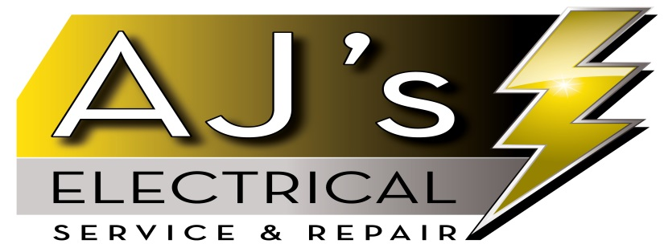
Do you want to cut down your ELECTRICAL BILLS!!
We have many solutions to help you achieve this goal .

Slide 5

Change your Halogen Light Bulbs to LED :
1. Puck lights
2. Pot Lights
3. Hood Fan lights
4. Track Lights

Slide 6

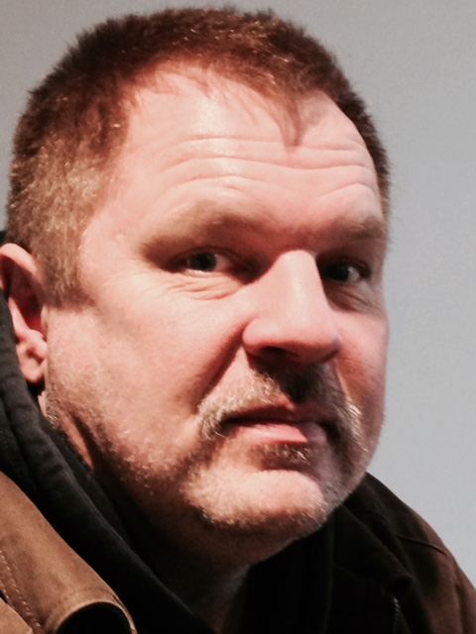
AJ’s Licensed Electricians

Slide 7

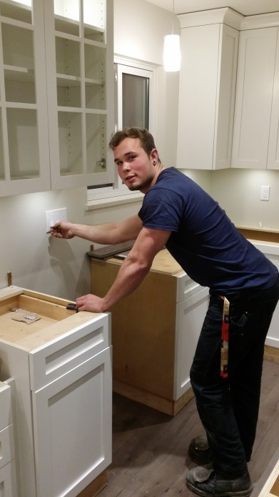
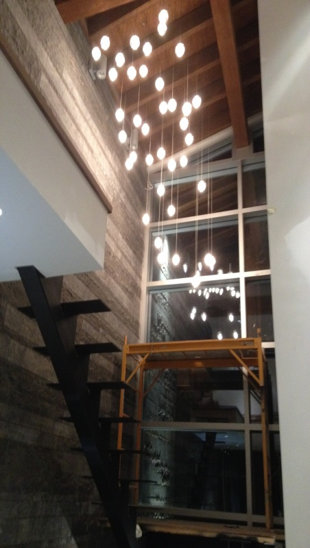
AJ’s Installations

Slide 8
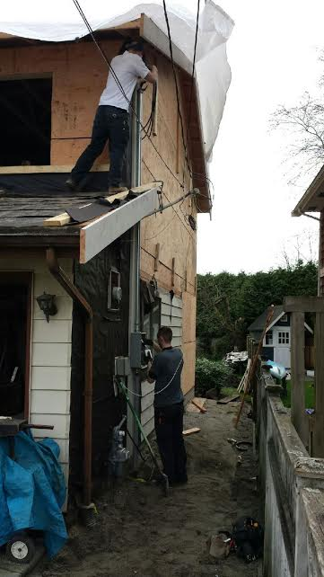
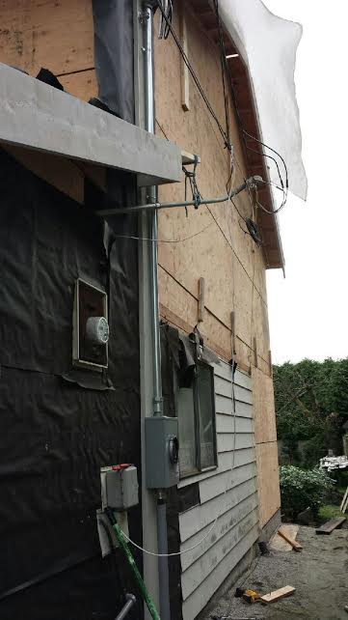
Service Panel Installations

Slide 9

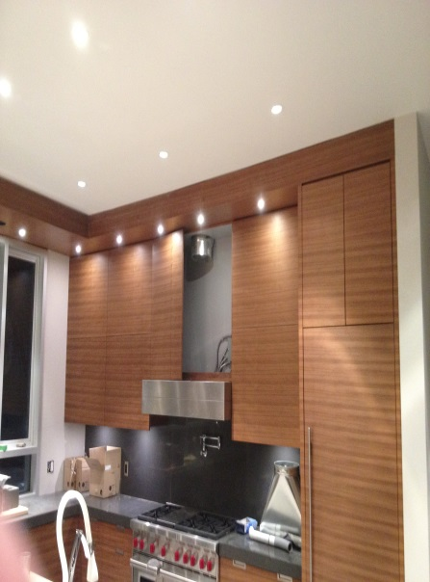
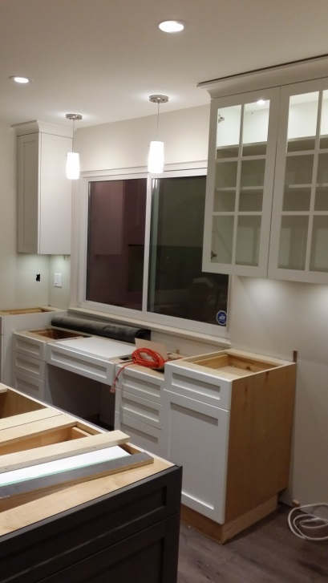
AJ’s Installations

Slide 10
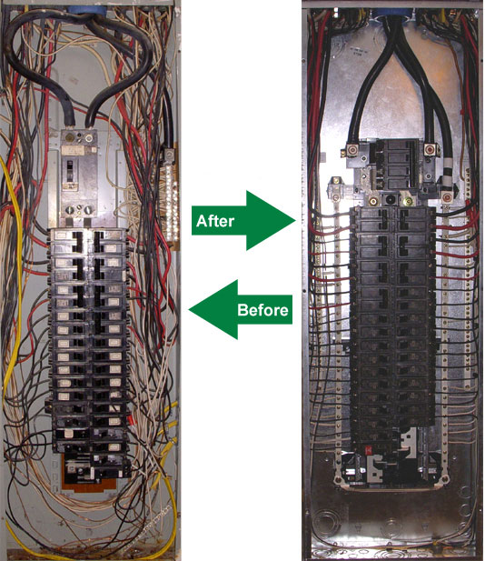
Main Panel Upgrade

Slide 11
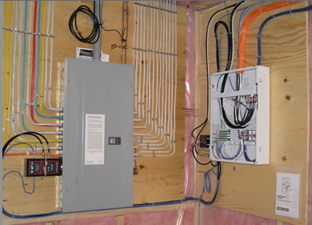
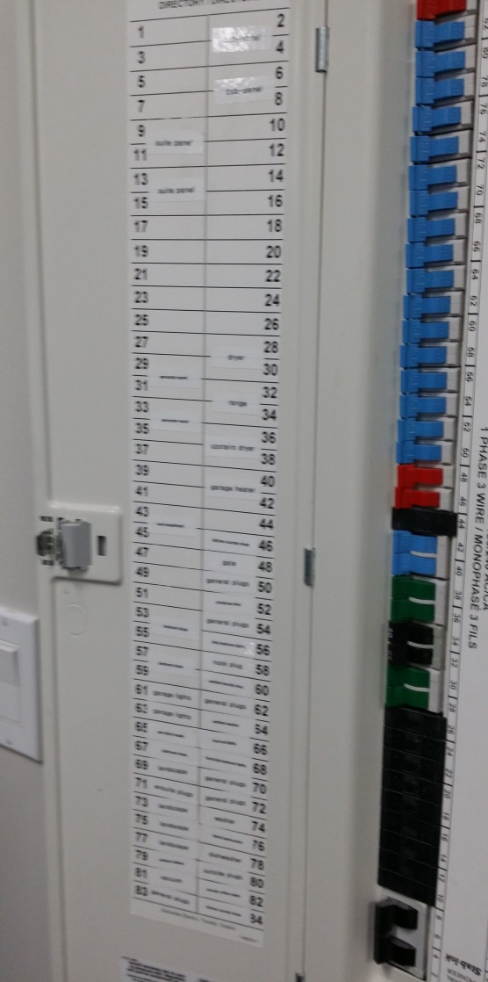
Upgrade your Panel with a Clean labelled Finish

Slide 12
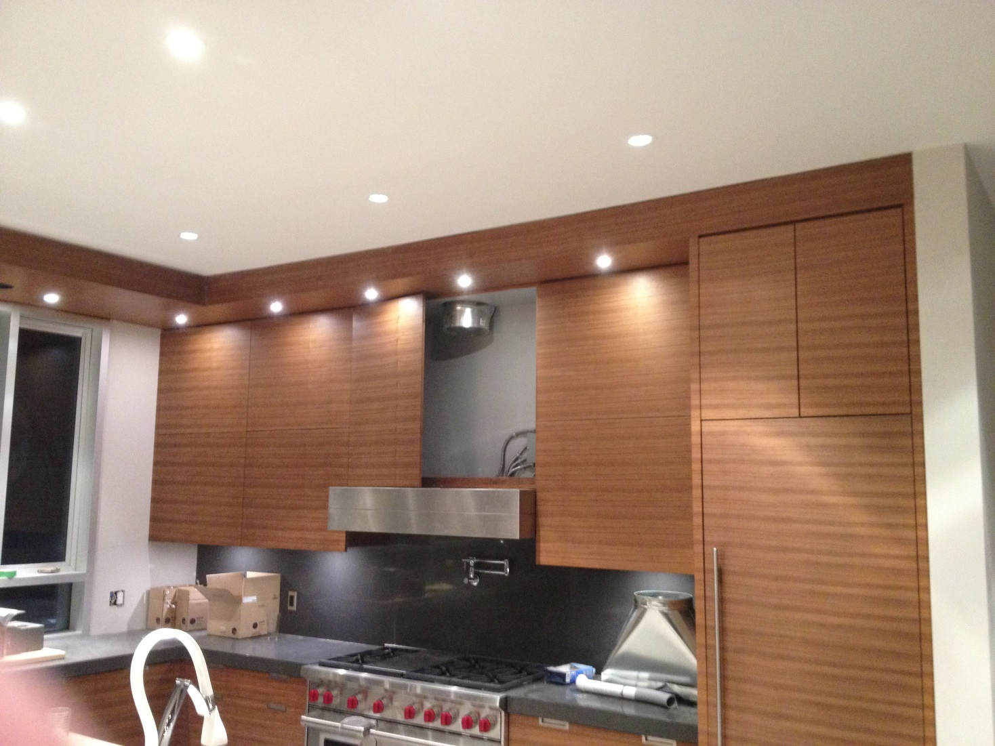
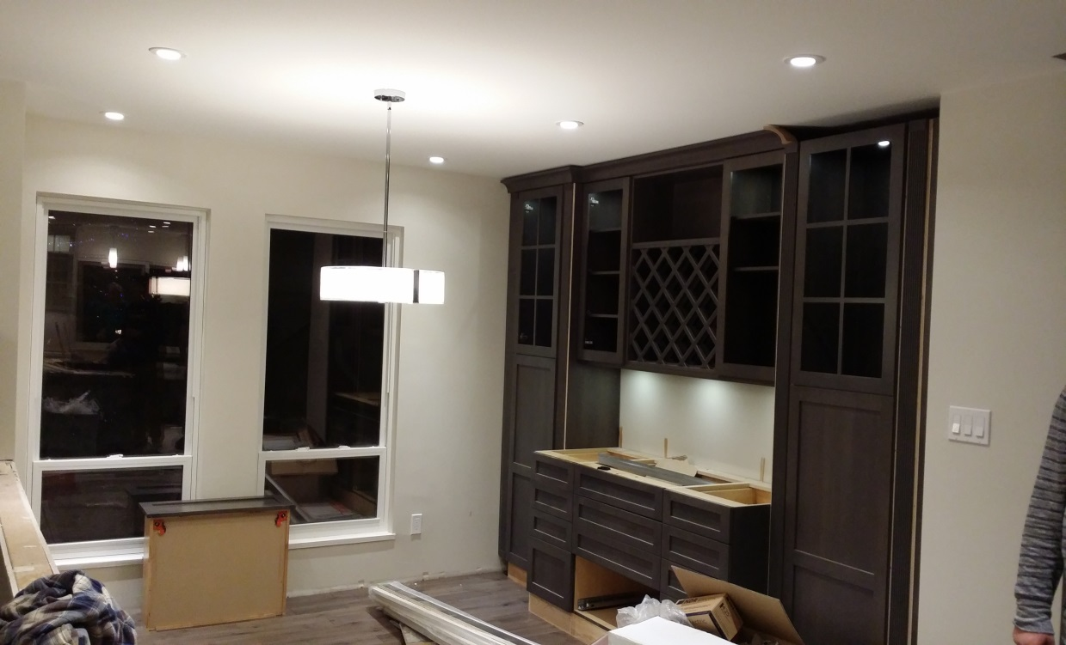
Installations

Slide 13
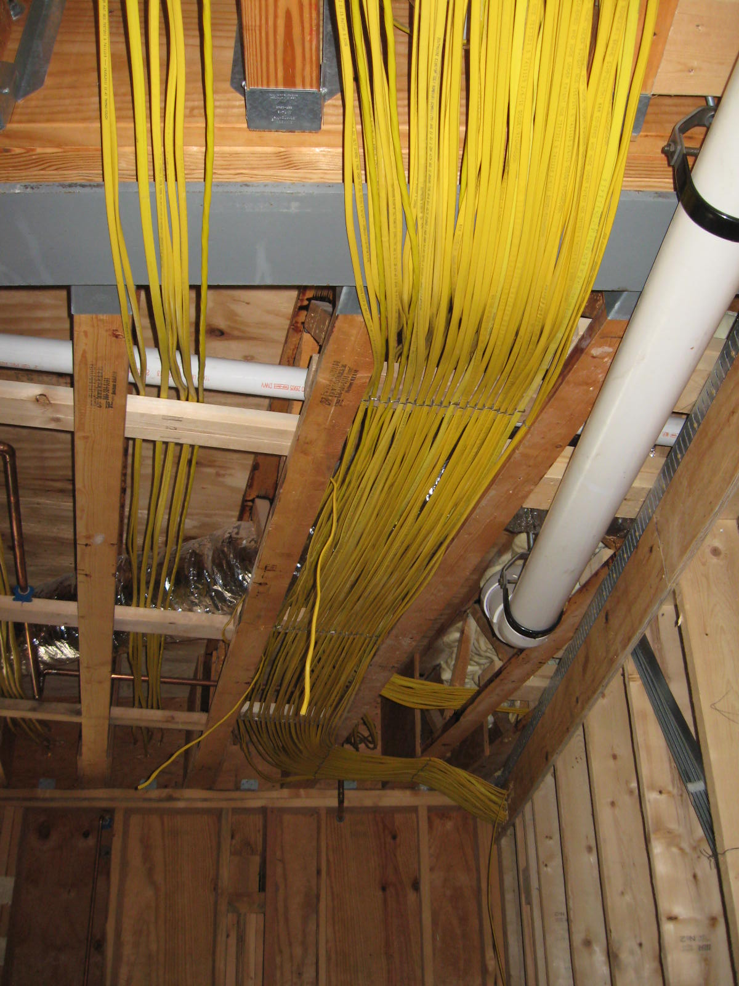
Clean Installations

Slide 14
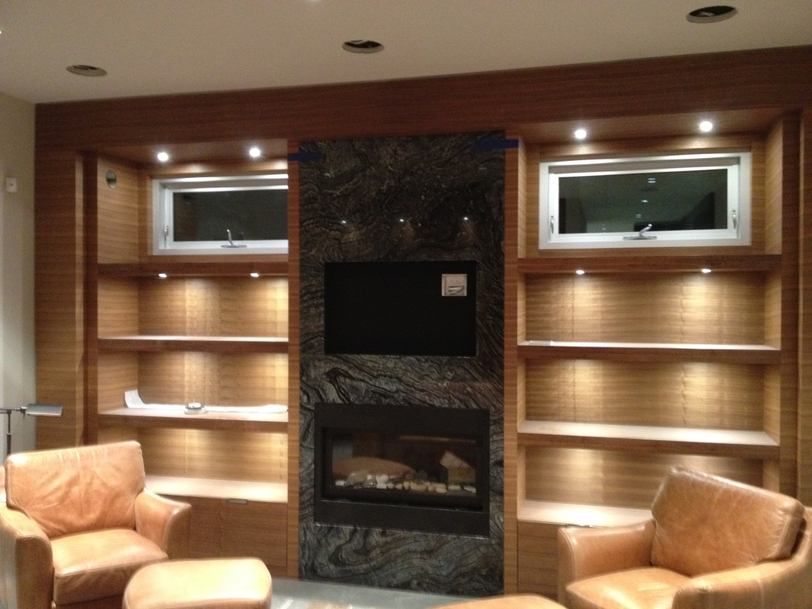
Finishing

Slide 15
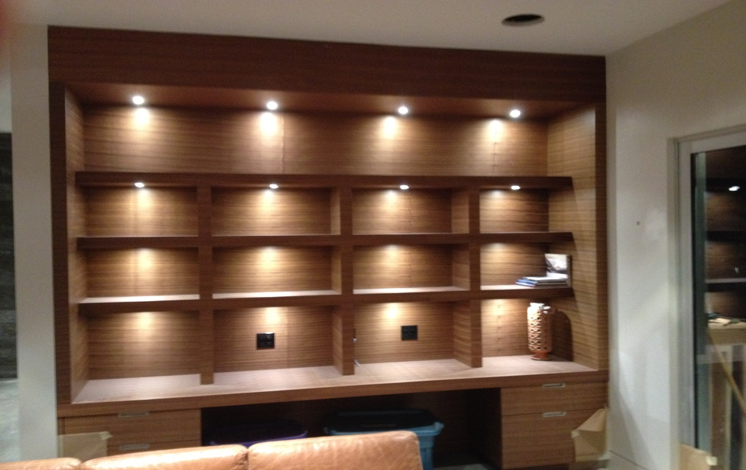
Finishing

Slide 16
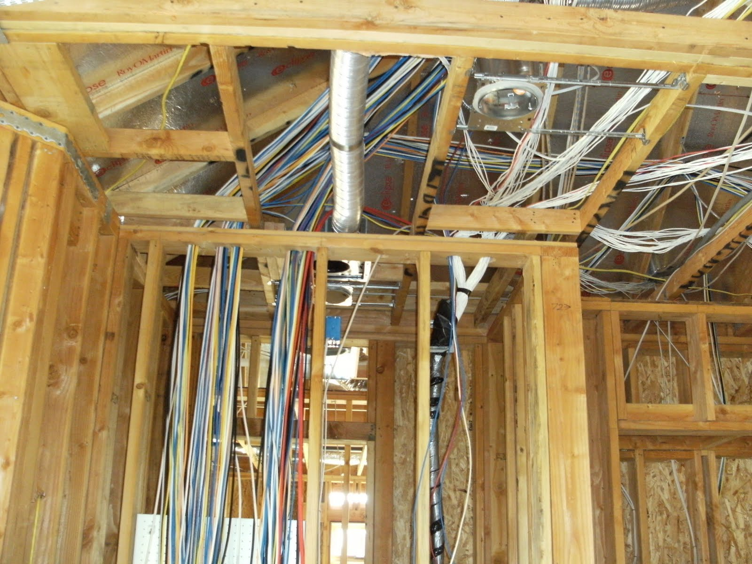
Projects from Full House to small Renovations

Slide 17
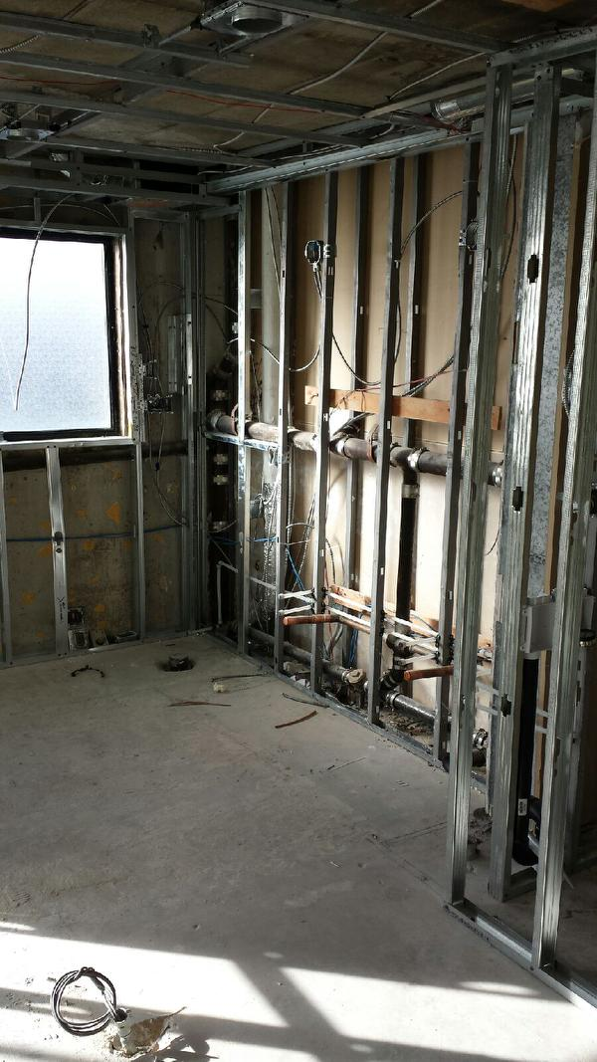
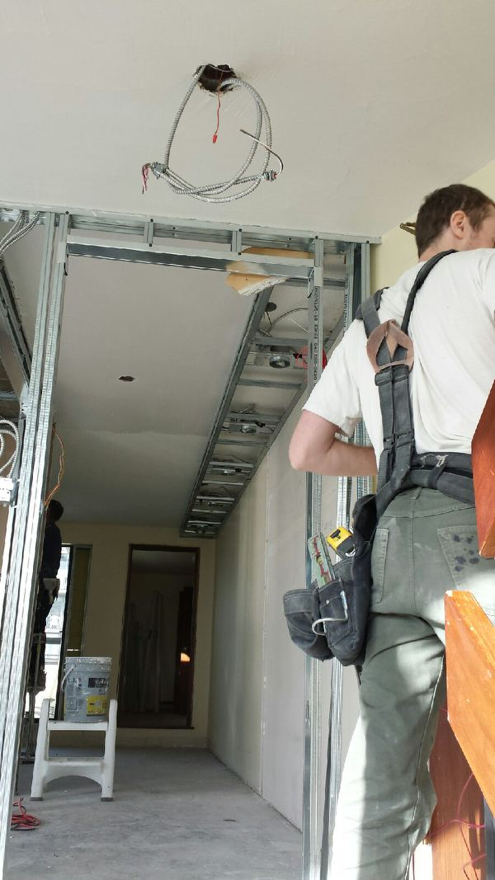
To Light Commercial Applications

Slide 18
Have questions about savings on your electrical bills
We can help !
Let Us come and Assess your home
Free Estimates

Slide 19
Let AJ’s
Protect your home from Electrical fire !
We can help !
Have your house inspected for electrical safety.

Slide 20
Ask Us About An
AJS
Home Electrical Safety Inspections
Regularly $200.00
TRADE SHOW SPECIAL ON NOW $149.99

Slide 21
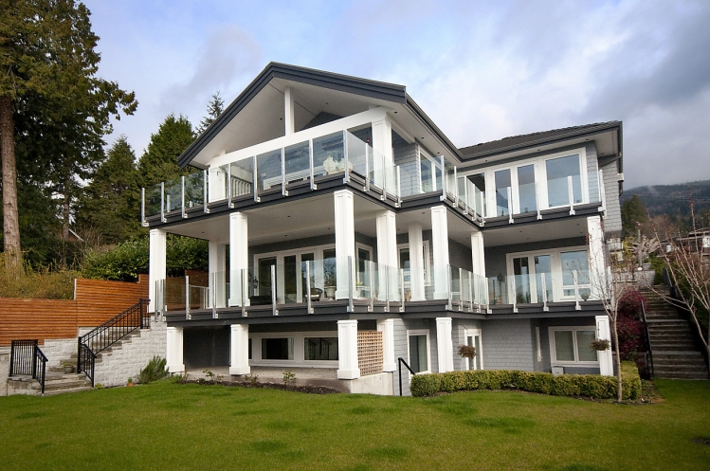
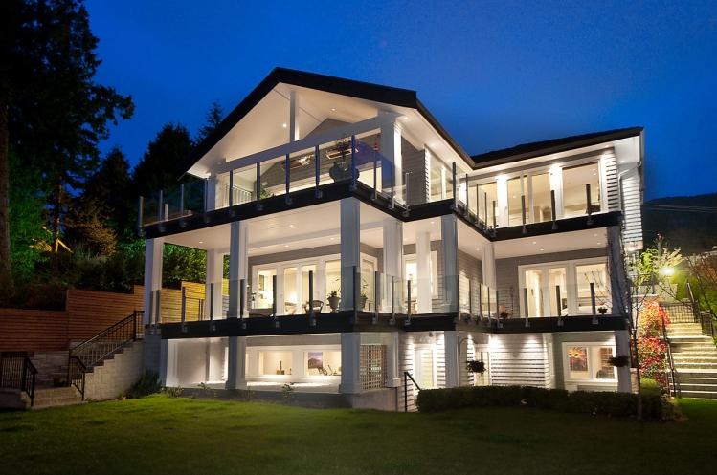
Ask us !!
about your next Renovation project or about updating your current residence .

